Slide 1

National drivers of rent
March 2023

Slide 2
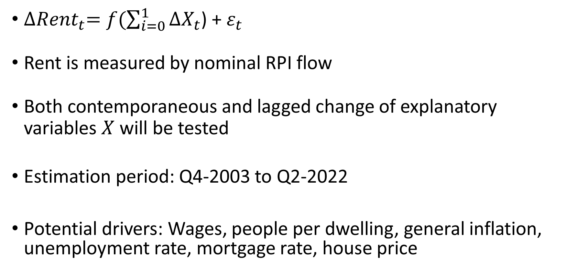
Model
${∆Rent}_{t}=f(\sum_{i=0}^{1}{{∆X}_{t}}$) + $ε_{t}$
Rent is measured by nominal RPI flow
Both contemporaneous and lagged change of explanatory variables $X$ will be tested
Estimation period: Q4-2003 to Q2-2022
Potential drivers: Wages, people per dwelling, general inflation, unemployment rate, mortgage rate, house price

Slide 3
Model – alternative specifications
Dependent variable
Stock measure of rent inflation
Real rent inflation
Explanatory variables
Exclude house price – related variables
Adult population
Separate population and dwelling growth
Vacancy rate
Frequency
Annual change with 4-period lags
Notes:
Longer time period
Not mixing up change and level
Stock and real measure
Controlling for population growth and dwelling growth separately
Quarterly noise
Lag selection (lag 1 is arbitrary, some relationships might be stronger contemporaneously)

Slide 4
Baseline
 | Rent inflation (nominal, flow) | Rent inflation (nominal, flow) | Rent inflation (nominal, flow) | Rent inflation (nominal, flow)
Predictors | Estimates | Estimates | Estimates | Estimates
Rent inflation (lagged) | -0.19 (0.12) | -0.19 * (0.11) | -0.17 (0.11) | -0.15 (0.11)
Wage growth | 0.54 *** (0.11) | 0.56 *** (0.08) | 0.54 *** (0.09) | 0.54 *** (0.09)
Wage growth (lagged) | 0.35 *** (0.12) | 0.36 *** (0.11) | 0.39 *** (0.12) | 0.39 *** (0.12)
People per dwelling | -0.51 (0.78)
People per dwelling (lagged) | 1.97 ** (0.86) | 1.73 *** (0.52) | 1.63 *** (0.53) | 1.51 *** (0.53)
Mortgage rate | 0.02 (0.02)
Mortgage rate (lagged) | 0.02 (0.02) | 0.03 (0.02) | 0.03 (0.02)
Inflation excluding rents | -0.12 (0.20)
Inflation excluding rents (lagged) | 0.15 (0.20) | 0.14 (0.17) | 0.13 (0.17) | 0.15 (0.17)
Unemployment rate | 0.01 (0.01)
Unemployment rate (lagged) | -0.02 (0.01) | -0.02 (0.01) | -0.02 (0.01) | -0.02 * (0.01)
House price inflation | -0.01 (0.06)
House price inflation (lagged) | 0.08 (0.07) | 0.08 * (0.04)
Observations | 73 | 73 | 73 | 73
R² / R² adjusted | 0.489 / 0.376 | 0.470 / 0.404 | 0.440 / 0.380 | 0.423 / 0.371
All variables enter the model as percentage change from the previous quarter * p<0.1 ** p<0.05 *** p<0.01

Slide 5
Alternative: Dependent variable
 | Rent inflation (nominal, flow) | Rent inflation (nominal, stock) | Rent inflation (real, flow)
Predictors | Estimates | Estimates | Estimates*
Rent inflation (lagged) | -0.17 (0.11) | 0.65 *** (0.10) | -0.27 ** (0.11)
Wage growth | 0.54 *** (0.09) | 0.09 *** (0.02) | 0.62 *** (0.08)
Wage growth (lagged) | 0.39 *** (0.12) | 0.09 *** (0.03) | 0.38 *** (0.12)
People per dwelling (lagged) | 1.63 *** (0.53) | 0.30 ** (0.14) | 1.99 *** (0.53)
Mortgage rate (lagged) | 0.03 (0.02) | 0.01 (0.00) | 0.03 (0.02)
Inflation excluding rents (lagged) | 0.13 (0.17) | 0.02 (0.04)
Unemployment rate (lagged) | -0.02 (0.01) | -0.00 (0.00) | -0.01 (0.01)
Observations | 73 | 61 | 72
R² / R² adjusted | 0.440 / 0.380 | 0.573 / 0.516 | 0.560 / 0.520
All variables enter the model as percentage change from the previous quarter In Model 3, both rents and wages are deflated using CPI excluding rents * p<0.1 ** p<0.05 *** p<0.01

Slide 6
Alternative: Explanatory variables
 | Rent inflation (nominal, flow) | Rent inflation (nominal, flow) | Rent inflation (nominal, flow) | Rent inflation (nominal, flow)
Predictors | Estimates | Estimates | Estimates | Estimates
Wage | 0.56 *** (0.08) | 0.52 *** (0.08) | 0.54 *** (0.09) | 0.34 *** (0.09)
Wage (lagged) | 0.36 *** (0.11) | 0.39 *** (0.11) | 0.39 *** (0.12) | 0.28 ** (0.12)
People per dwelling (lagged) | 1.73 *** (0.52)
Adults per dwelling (lagged) |  | 1.46 *** (0.46)
Population growth (lagged) |  |  | 1.68 *** (0.58)
Dwellings growth (lagged) |  |  | -1.43 (0.97)
Change in vacant time (lagged) |  |  |  | -0.01 *** (0.00)
Observations | 73 | 73 | 73 | 73
R² / R² adjusted | 0.470 / 0.404 | 0.445 / 0.385 | 0.441 / 0.371 | 0.457 / 0.398
All variables enter the model as percentage change from the previous quarter * p<0.1 ** p<0.05 *** p<0.01

Slide 7
Alternative: Annual frequency
 | Annual rent inflation (nominal, flow)
Predictors | Estimates
Rent inflation (t-4) | -0.54 *** (0.14)
Wage | 0.62 *** (0.10)
Wage (t-4) | 0.75 *** (0.14)
People per dwelling (t-4) | 1.18 *** (0.38)
Floating mortgage rate (t-4) | 0.01 (0.02)
Inflation excluding rents (t-4) | -0.37 *** (0.12)
Unemployment rate (t-4) | -0.03 ** (0.01)
Observations | 67
R² / R² adjusted | 0.508 / 0.449
All variables enter the model as change from the same quarter last year * p<0.1 ** p<0.05 *** p<0.01

Slide 8
Interaction
 | Quarterly rent inflation (nominal, flow)
Predictors | Estimates
Wage (rolling two-period average) | 0.98 *** (0.15)
People per dwelling (lagged) | 1.57 *** (0.54)
Wage x People per dwelling | 0.04 (0.62)
Observations | 73
R² / R² adjusted | 0.430 / 0.368
All variables enter the model as percentage change from the previous quarter * p<0.1 ** p<0.05 *** p<0.01

